Slide 1

Design and Development of a Custom Assembly Language Compiler and Execution Engine
CSA1233-COMPUTER ARCHITECTURE
Project Supervisor
Dr Senthil vadivu.S
Dr Kumaragurubaran T
Professor
Department of computer science
SSE, SIMATS
Student Name : DHARANI THARAN .G
Reg Number : 192511396
Student name : SRIVANTH.E
Reg Number : 192512428
Student Name : PERUMAL .S
Reg Number : 192512435

Slide 2
List of Contents
S No | Content
1 | Introduction
2 | Goals & Non-Goals
3 | Requirements
4 | Instruction Set Architecture (ISA)
5 | Binary Encoding
6 | Assembly Language Syntax
7 | Toolchain Architecture
8 | Implementation Plan
9 | conclusion

Slide 3


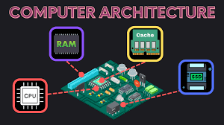
Introduction
Programming languages → bridge between humans
and machines
High-level languages abstract complexity
Assembly hardware
Importance:
language: close to machine, reflects
Understanding compilers, execution
engines, and CPU design

Slide 4

Goals & Non-Goals
Goals
Educational yet realistic ISA.
Human-friendly assembly syntax.
Deterministic execution engine.
Portable reference implementation.
Clear separation of assembler and VM with a stable
IR.
Non-Goals
Binary compatibility with existing architectures.
Peak native performance.
Advanced CPU features like speculation.

Slide 5
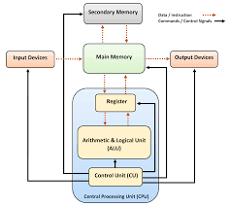

Requirements
Functional
Assemble assembly source into bytecode and run
on VM.
Support basic data types and a flat memory model.
I/O via simple interrupts.
Tooling: symbol maps, listing, debug info.
Non-Functional
Portability across major OSes.
Deterministic results.
Readable, tested code.

Slide 6
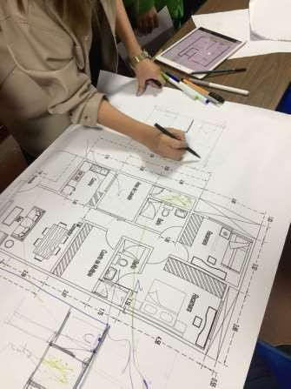
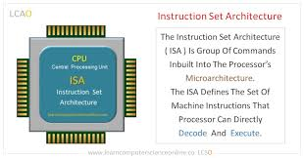
Instruction Set Architecture (ISA)
Registers: r0–r7, sp, bp, ip, fl.
Flags: Zero, Negative, Carry, Overflow.
Addressing Modes: Immediate, Register, Base+disp, Pre/Post
inc/dec.
Instructions: MOV, LD, ST, PUSH, POP, ADD, SUB, MUL, DIV, AND, OR, XOR, NOT, SHL, SHR, CMP, TST, JMP, JZ, JNZ, CALL, RET, INT, HLT.
Calling Convention: Caller saves r0–r3, callee saves r4–r7
and bp.

Slide 7

Binary Encoding
Fixed 32-bit words.
Fields: OP(8) | MOD(4) | RD(4) | RS(4) | EXT(12).
Larger immediates use extra word.
EXAMPLE:
ADD r1, r2 ; OP=0x10
LD r3, [r4+16] ; OP=0x21
JZ label ; OP=0x40

Slide 8
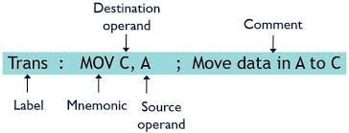

Assembly Language Syntax
Identifiers, numbers (dec/hex/bin), comments (;).
Directives: .text, .data, .bss, .global, .byte, .word, .asciz.
Supports labels, macros, includes.
Example:
.text
.global _start
_start:
MOV r0, #5
MOV r1, #7
ADD r0, r1
HLT

Slide 9
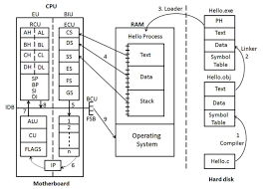
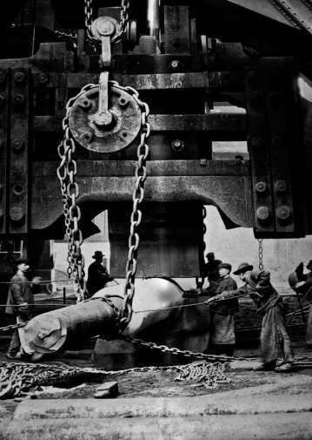
Toolchain Architecture
Assembler: Lexer → Parser → IR → Encoder →
Object file.
Linker: Combines objects into executable.
VM (Interpreter): Fetch-decode-execute loop.
Debugger: Breakpoints, step, inspect registers/memory.

Slide 10

Implementation Plan
Phase 1 – Assembler Core: Lexer, parser, encoder.
Phase 2 – VM Interpreter: CPU state,
memory, execution loop.
Phase 3 – Tooling: Disassembler, linker,
debugger.
Phase 4 – Optimization (optional): Peephole optimizer, JIT prototype.
8
This Photo by Unknown Author is licensed under CC BY-NC

Slide 11
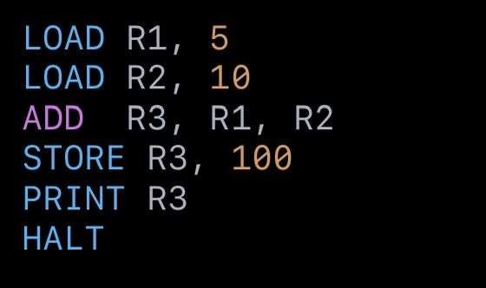
SAMPLE OUTPUT
9

Slide 12
Conclusion
Built a complete pipeline: Assembly → Compiler → Execution Engine
Demonstrated practical understanding of compilers and CPU design
Provides educational value and foundation for further extensions
10

Slide 13
THANK YOU
11

